Slide 1
Introduction to Statistics for Ecology and Evolutionary Biology More Multilevel Modeling Week 15 04 May 2020
Notes:
The goal for this lecture to communicate the “why” and “when” of multilevel modeling
Notes regarding model-fitting with Stan:
variable names with dots – Stan will want to remove these
divergent iterations – You can ignore these warnings for the purposes of our course
extracting samples from the model – Can’t ask for more samples than you asked Stan to fit

Slide 2
Notes:
https://upload.wikimedia.org/wikipedia/commons/b/ba/Data_visualization_process_v1.png

Slide 3
Data Analysis Process
Data collection (not covered in this course)
Data processing (Weeks 1, 2)
Exploratory data analysis (Weeks 3, 5)
Data summary and visualization
Statistical analysis (Weeks 4, 6-15)
Data communication/presentation (Weeks 1, 3)

Slide 4
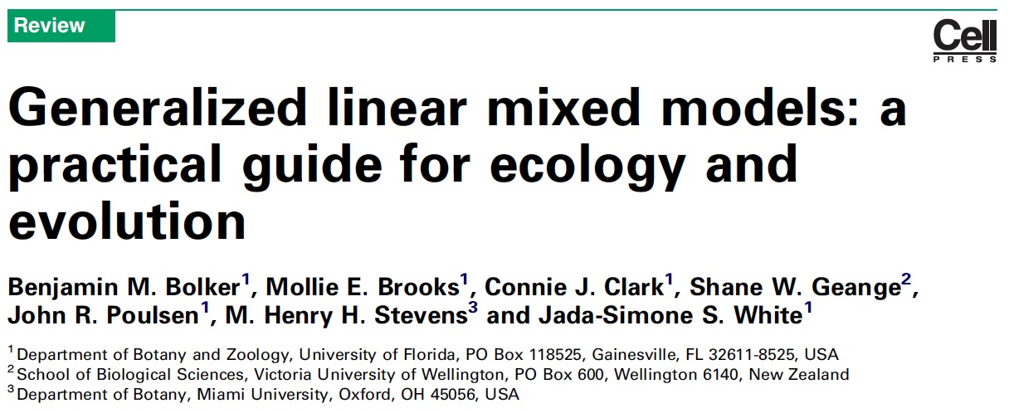
Bolker et al. 2009, Trends in Ecology & Evolution
Notes:
This paper serves as a good introduction to the topic and lays out much of the terminology for those interested

Slide 5
What are Varying (i.e., Random) Effects?
“Where basic statistical methods try to quantify the exact effects of each predictor variable, EE problems often involve random effects, whose purpose is instead to quantify the variation among units. The most familiar types of random effect are the blocks in experiments or observational studies that are replicated across sites or times. Random effects also encompass variation among individuals (when multiple responses are measured per individual, such as survival of multiple offspring or sex ratios of multiple broods), genotypes, species and regions or time periods.”
Bolker et al. 2009, Trends in Ecology & Evolution
Notes:
All of the variable described here could be construed as “clusters” of data

Slide 6
What are Varying (i.e., Random) Effects?
“Random effects: factors whose levels are sampled from a larger population, or whose interest lies in the variation among them rather than the specific effects of each level. The parameters of random effects are the standard deviations of variation at a particular level (e.g. among experimental blocks). The precise definitions of ‘fixed’ and ‘random’ are controversial; the status of particular variables depends on experimental design and context [16,53].”
Bolker et al. 2009, Trends in Ecology & Evolution
Notes:
Note that variation is mentioned again as central to the definition
But also, the definition is controversial

Slide 7
What are Varying (i.e., Random) Effects?
“It is important to distinguish between random effects as a nuisance (as in classical blocked experimental designs) and as a variable of interest (as in many evolutionary genetic studies, or in ecological studies focused on heterogeneity).”
Bolker et al. 2009, Trends in Ecology & Evolution
Notes:
So the “importance” of a variable for interpretation is not really a good way to distinguish random from fixed effects since random effects can be either a “nuisance” or a “variable of interest”
Thus, for this class we’ll prefer to say that varying/random effects are those that are explicitly constructed in our models such that they are derived from a population of effects (i.e., constructed with hyperparameters that govern their parameter estimates)

Slide 8
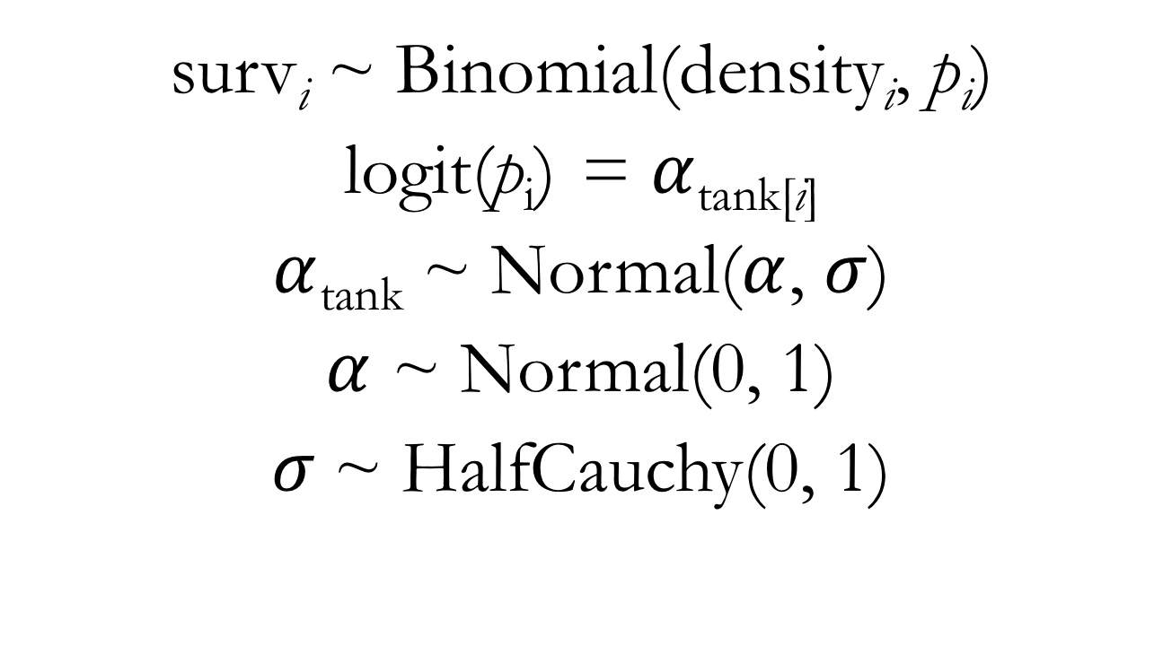
Binomial Multilevel Model for Reed Frog Survival Predictors: Tank (with an indexing approach)
surv_{i} ~ Binomial(density_{i}, $\text{p}\text{i}$)
logit(p_{i}) = $α$_{tank[i]}
$α$_{tank} ~ Normal($α$, $σ$)
$α$ ~ Normal(0, 1)
$σ$~ HalfCauchy(0, 1)
Notes:
Point out that the mathematical structure of the varying effects is always a reliable way to identify them
And this is their most precise, strict definition

Slide 9
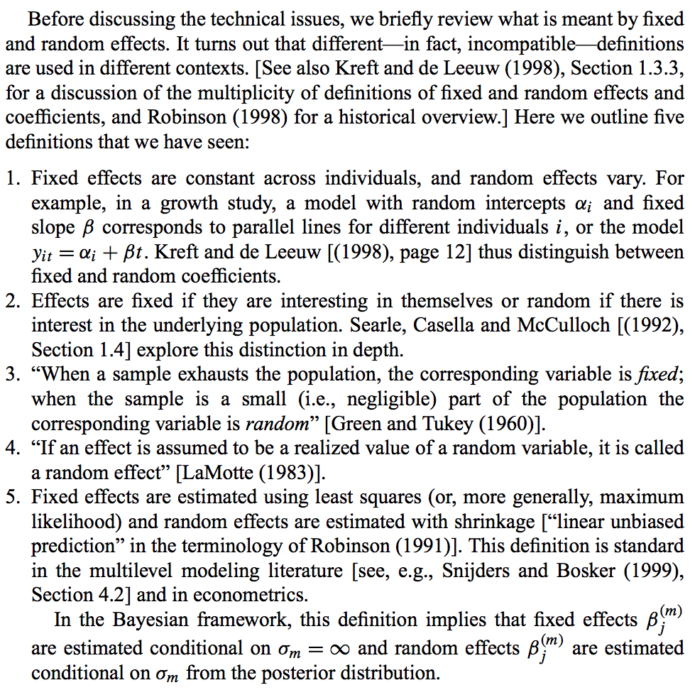
Gelman 2005, The Annals of Statistics
Notes:
One line summary: The random effects terminology is incredibly inconsistent and confusing
Note that with definition 2, the exact same set of estimates from a model would be fixed or random depending upon your interest as an investigator

Slide 10
Benefits of Multilevel Models
Improved estimates for repeated sampling
Simpler, traditional models maximally overfit or underfit data in this context
Improved estimates for imbalanced sampling
If ignored, over-sampled units in the data will dominate inference
Estimating variation
Multilevel models are explicitly focused on variation
Avoid averaging

Slide 11
Conceptualizing Multilevel Models
Can be viewed as a form of adaptive regularization
In these models, the amount of regularization is learned from the data itself
Help to navigate the risk of overfitting and underfitting
If we use completely independent parameters (no pooling), we risk overfitting. If we ignore variation in the variable of interest (complete pooling), we risk underfitting
The multilevel strategy represents partial pooling of information

Slide 12
The Magic of Shrinkage
Shrinkage in parameter estimates manifests from the regularization inherent in multilevel models
It is the pulling of the multilevel estimates towards the estimated global average across clusters
Could be thought of as a form of regression to the mean
The effects of shrinkage tend to be greatest when:
Sample sizes for a cluster are small
The empirical estimate for a cluster’s parameter value are extreme
Notes:
Show lecture code illustrating shrinkage

Slide 13
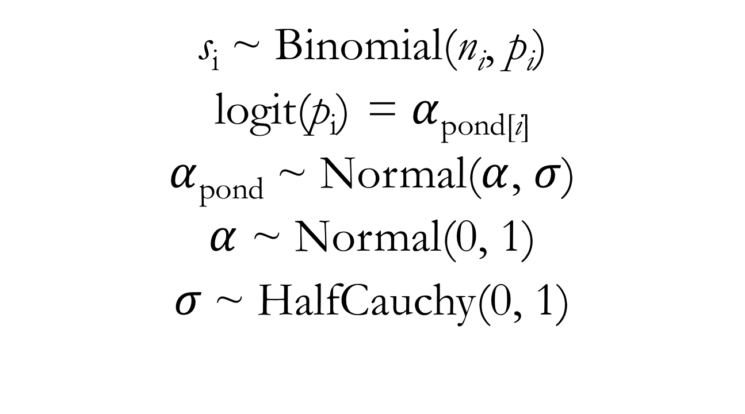
Binomial Multilevel Model for Frog Survival Predictors: Ponds (instead of tanks)
s_{i} ~ Binomial(n_{i}, $\text{p}\text{i}$)
logit(p_{i}) = $α$_{pond[i]}
$α$_{pond} ~ Normal($α$, $σ$)
$α$ ~ Normal(0, 1)
$σ$~ HalfCauchy(0, 1)
Notes:
Show lecture code on simulating frog survival data

Slide 14
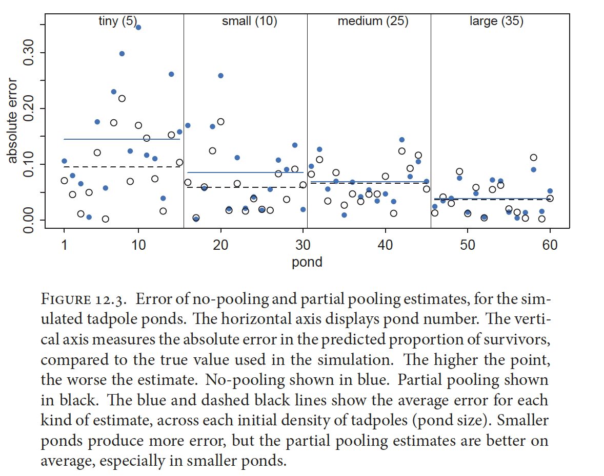
McElreath 2016, Statistical Rethinking

Slide 15
Binomial Multilevel Model for Reed Frog Survival Predictors: Tank (with an indexing approach)
surv_{i} ~ Binomial(density_{i}, $\text{p}\text{i}$)
logit(p_{i}) = $α$_{tank[i]}
$α$_{tank} ~ Normal($α$, $σ$)
$α$ ~ Normal(0, 1)
$σ$~ HalfCauchy(0, 1)

Slide 16
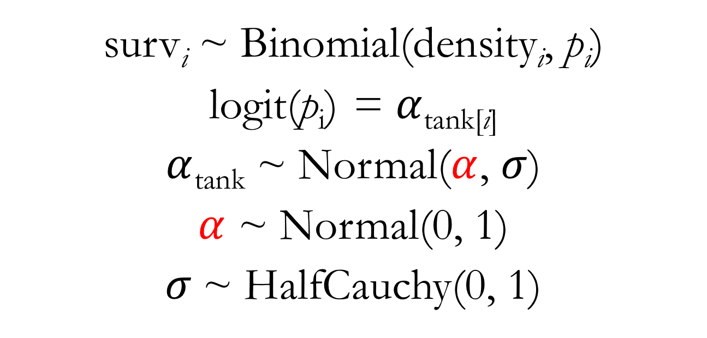
Binomial Multilevel Model for Reed Frog Survival: Movin’ Around the Mean Predictors: Tank (with an indexing approach)
surv_{i} ~ Binomial(density_{i}, $\text{p}\text{i}$)
logit(p_{i}) = $α$_{tank[i]}
$α$_{tank} ~ Normal($α$, $σ$)
$α$ ~ Normal(0, 1)
$σ$~ HalfCauchy(0, 1)

Slide 17
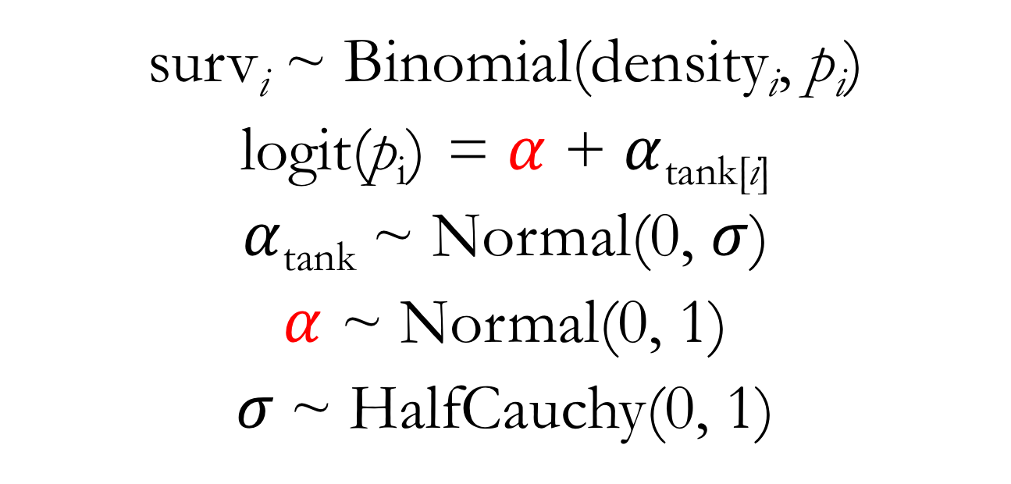
Binomial Multilevel Model for Reed Frog Survival: Movin’ Around the Mean Predictors: Tank (with an indexing approach)
surv_{i} ~ Binomial(density_{i}, $\text{p}\text{i}$)
logit(p_{i}) = $α$ + $α$_{tank[i]}
$α$_{tank} ~ Normal(0, $σ$)
$α$ ~ Normal(0, 1)
$σ$~ HalfCauchy(0, 1)
Notes:
Note that this modeling strategy is critical for the inclusion of multiple varying effects in our models
It also means that our a_tank values are now going to represent DEVIATIONS (in log-odds space) relative to the global intercept value (a)
Show lecture code on fitting the model with this alternate parameterization

Slide 18
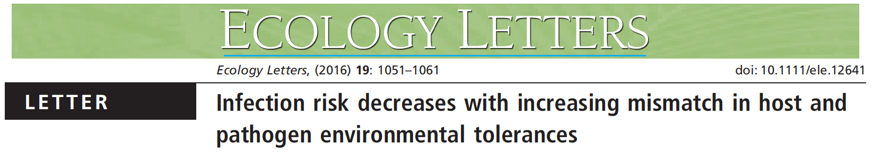
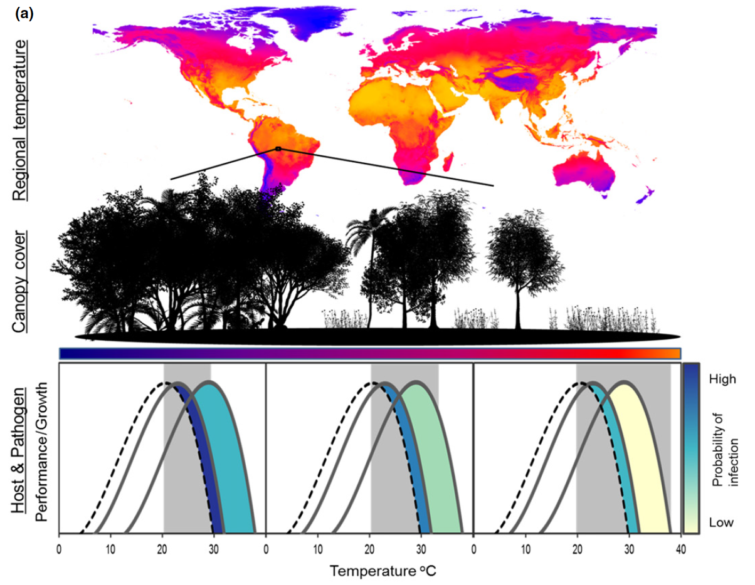

Slide 19
Multilevel Models in the Wild
“The response consisted of the number of infected and uninfected individuals at a given sample location (1,240 total sample locations) for a given species (53 total species); observations, therefore, represented species-by-site prevalence records (n = 1,645) weighted in the model by the number of Bd assays conducted for each species-by-site record (11,435 total assays). We fit all models with varying intercepts among contributing studies and among species nested within families and compared models fit with competing fixed effects structures.”
Nowakowski et al. 2016, Ecology Letters
Notes:
So we used aggregated binomial data here

Slide 20
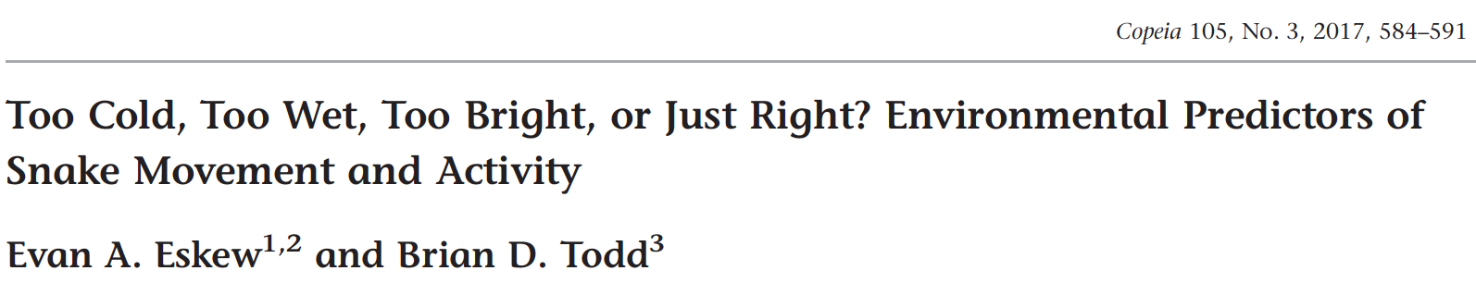
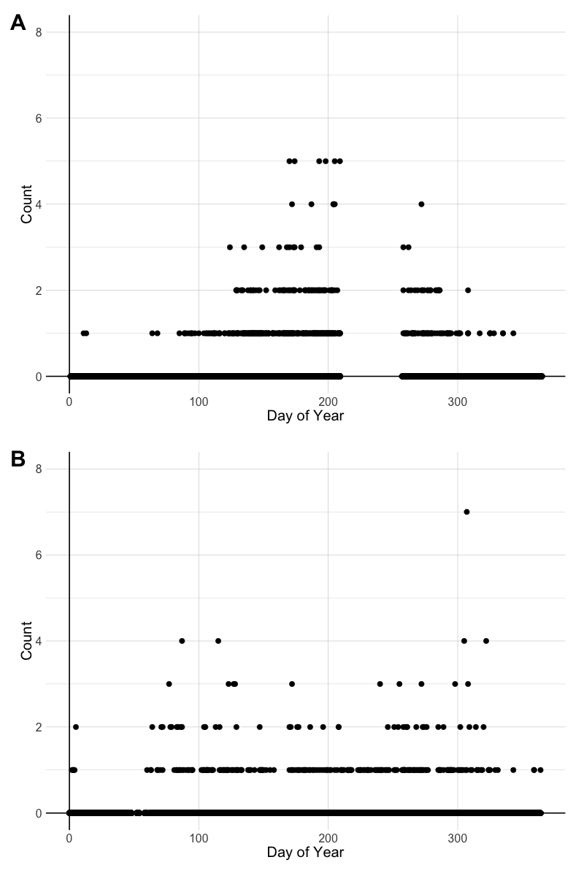
Notes:
All LEAP sites are shown in panel A, whereas Ellenton Bay is illustrated in panel B

Slide 21
Multilevel Models in the Wild
“We also wanted to control for variability in counts that could be attributed to snake species identity and sampling location. Thus, all LEAP models included varying intercepts (i.e., random effects) by snake species and sampling location, whereas Ellenton Bay models only included varying intercepts by snake species since all these data came from a single location. Critically, the inclusion of varying effects by species helps to make our inferences generalizable across the entire snake assemblage rather than being species-specific since inherent differences in activity among species are being accounted for…”
Eskew and Todd 2017, Copeia

Slide 22
Course Takeaways
Simplicity and power of Bayesian updating
Embrace and communicate uncertainty
Convey model results through visualization and implied prediction, not (just) tables of estimates
Be wary of overfitting
Models motivated by science, not statistics
A general framework with many specific implementations
Notes:
Bayesian models update prior information based on data to which we expose them
A simple framework for thinking about the process of statistical inference
Highly informative data result in more informative posteriors; data with limited sample size or weak trends will be reflected in posterior uncertainty
Acknowledging the uncertainty in our models, as represented by the model posterior, is central to Bayesian inference
Focuses us on the full posterior distribution rather than point estimates
Predictions on the scale of our outcome data are almost always easier to interpret than tables of parameter estimates
Multilevel approaches help us address overfitting by default
No matter the savviness/complexity of our modeling approaches, our models cannot do the really hard work of getting us to ask them precise, insightful scientific questions
My hope is that rather than statistical recipes, you’ve gathered some familiarity with statistical “cooking” that can serve you well as you implement these methods and move on to others

Slide 23
Thank You!

